Slide 1
Health Score Algorithm
Cloud Data Hub
Health Score
Stock
Health Score Model
Health
Score
x
Safety Stock
…
Contributing Factors (Phase 2)
Demand
Inputs
Outputs

Slide 2
Health Status KPI
Health Status is an indicator variable (integer of 0-100) of the relative ‘wellbeing’ of a part’s supply.
It is used to predict the likelihood of a parts supply running out or low and can assist material planners in making more informed decisions for ordering parts.
It takes into account the current status of a parts supply as well as the projected data for the following 10 days to inform it’s estimate.
The Health Status is derived via a nonlinear function which has the ability to evolve with the changing parts supply.

Slide 3
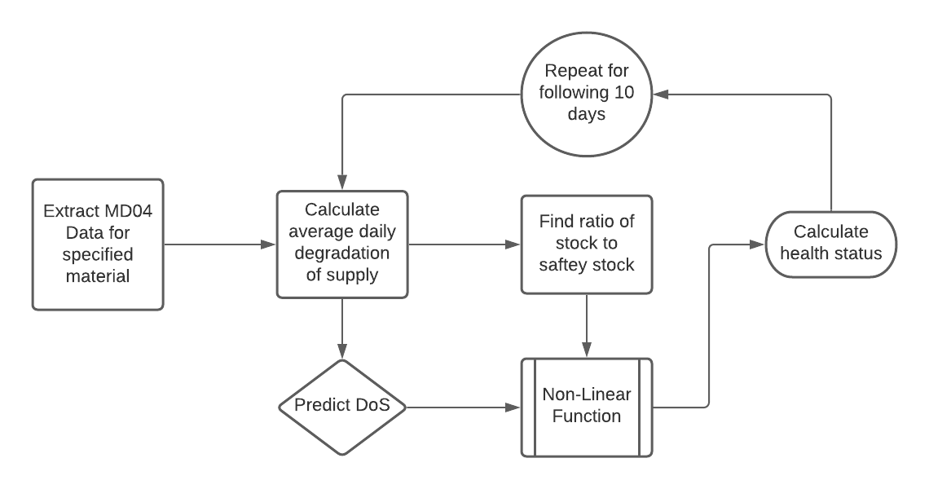
Health Score Model

Slide 4
MD04 Elements for Algorithm
MRP Element | Description
Stock | An Initial stock value
DepReq | It specifies requirement/demand/consumption of a part.
ShipNt | Number of stck in transit; The trailer which is carrying the parts is in transit. It is expected to be at the delivery location on a demand date.
SchAgr | The quantity of stck we are expecting to collect from a supplier. It will be delivered on a demand date.
IndReq | Order Forecast of stock
SafeSt | It specifies the quantity whose purpose is to satisfy unexpectedly high demand in coverage period. The risk of shortfalls is reduced by having a safety stock.

